Slide 1
New Topics
Hy-Tech Club: Python 201

Slide 2

Imports
How do we share code in Python?
Imports in Python
import math
print(math.pi)
print(math.pow(5, 2))
Import a whole module by name
Use the module
Notes:
Sharing code is a problem that all programming languages need to solve. Obviously, we can’t all share the same computer, there needs to be a way to share code across different programs to save time and be more efficient.
“Don’t reinvent the wheel!”
Python has an import system that allows programmers to pull in modules, classes and functions and use them within their programs.
In Python, a module can be imported by name using the “import” statement.

Slide 3

Package managers
Imports allow sharing code, but you also need a way to download code!
Package managers allow this to work.
In Replit, the Poetry Package Manager for Python is already configured and works automatically!
So, just import the library you want to use and Replit does the rest for you!
Notes:
For example, we will be using
Import discord
In the code-along for this lesson.

Slide 4


F strings
name = "John"
x = f"Hi, {name}!"
print(x)
Hi, John!
f before ""
{ and } around exprs
Notes:
F strings allow for string interpolation – basically, you can put expression values inside of strings without having to append them
Take a look at this example we have two variables – the x variable uses the name variable to create its value! What will be printed when the code runs?
It says “Hi, John!”
These are just like normal strings, but they have the letter ‘f’ in front of them. Then, within the strings, curly brackets can surround expressions

Slide 5
More New Topics
async/await 🕟
Discord.py API 👾
Replit Secrets 🔒
Function Decorators 🎃
Keyword Arguments 🔑
❓
Notes:
There are a ton of additional topics that we will need to use to make the Discord bot work.
It is more important to be able to use these things than actually understand them, so here are some rapid-fire examples

Slide 6

More New Topics – async/await 🕙
async def long_thing():
await start.process()
Sometimes, processes take a while
Like reading from a database, or going through an API
The await keyword lets functions wait for these to complete
Functions that wait for things must be marked async
Notes:
These keywords allow Python to do things that take a while without completely freezing execution. We will use async and await to send messages in discord.

Slide 7
More New Topics – Discord.py API 👾
What’s an API? Application Programming Interface
A way to access features and data of another system
The Discord.py API allows developers to do a lot with code:
Read messages
Send messages
Moderate channels
So much more!
https://discordpy.readthedocs.io/en/stable/
https://discordpy.readthedocs.io/en/stable/quickstart.html
Notes:
Students should check out the docs to learn more. In general, the ability to read documentation and learning how to work with APIs is one of the most powerful skills a programmer can learn.

Slide 8
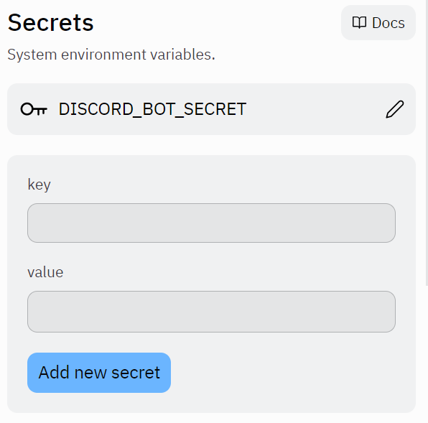

More New Topics – Replit Secrets 🔒
Why?
Some things (like passwords or access tokens) should be hidden
Since all Repls are public, hard-coding these values is not an option
Secrets allow these values to be used in code without being visible
How?
Notes:
Replit secrets are a way to store sensitive data in programs. They can be accessed through the os of the Replit virtual machine – this will be built into the starter code for the discord bot.

Slide 9
More New Topics – Function Decorators 🎃
@do_twice
def say_hi():
print("hi")
Decorators wrap functions
Defining them can be complex, but using them is not as difficult
Above the definition
@ symbol
Decorator name
Notes:
Decorators are very complex, but can be used very simply. Just do @something to wrap a function with some other function. We will use decorators to designate which functions should respond to Discord API events (e.g., logged in, received message).
https://realpython.com/primer-on-python-decorators/

Slide 10
More New Topics – Keyword arguments 🔑
def team(name, proj="Web"):
print(f"{name} --> {proj}")
team("Cher")
team(proj="Bot", name="Cher")
Notes:
Keyword arguments are a way to pass values to functions by name instead of by order. Usually, you would just pass the values, and the function would know the order. With keyword arguments (or kwargs), parameters can be specified. This helps make code clearer, and enables functions with default parameter values (like proj=“Web”).
https://www.educative.io/answers/what-are-keyword-arguments-in-python

Slide 11
https://replit.com/@HylandOutreach/NewPythonTopics
Notes:
This Repl project uses:
Import
Packages
F Strings
Async/Await
Replit Secrets
Decorators
Keyword Arguments
Emphasize that students do not need to fully understand these concepts in order to use them to create some great bots!

Slide 12
Questions?

